Slide 1

Chapter 3 Differentiation Rules
Introduction

Slide 2
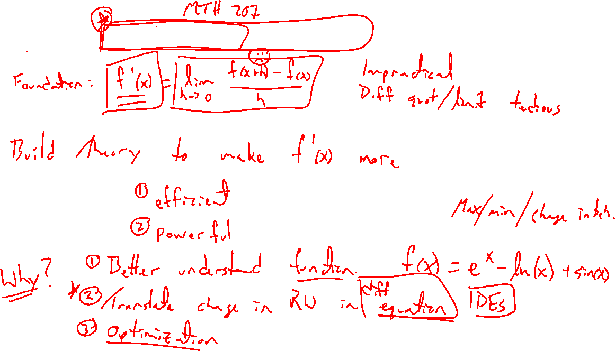
Story of differential calculus
Notes:
Difference quotient is a pain, need to keep building a theory to make diff easier.
Why? Understand functions better, translate change to equation, optimization, etc
Demo differential equation simulation: CFD

Slide 3
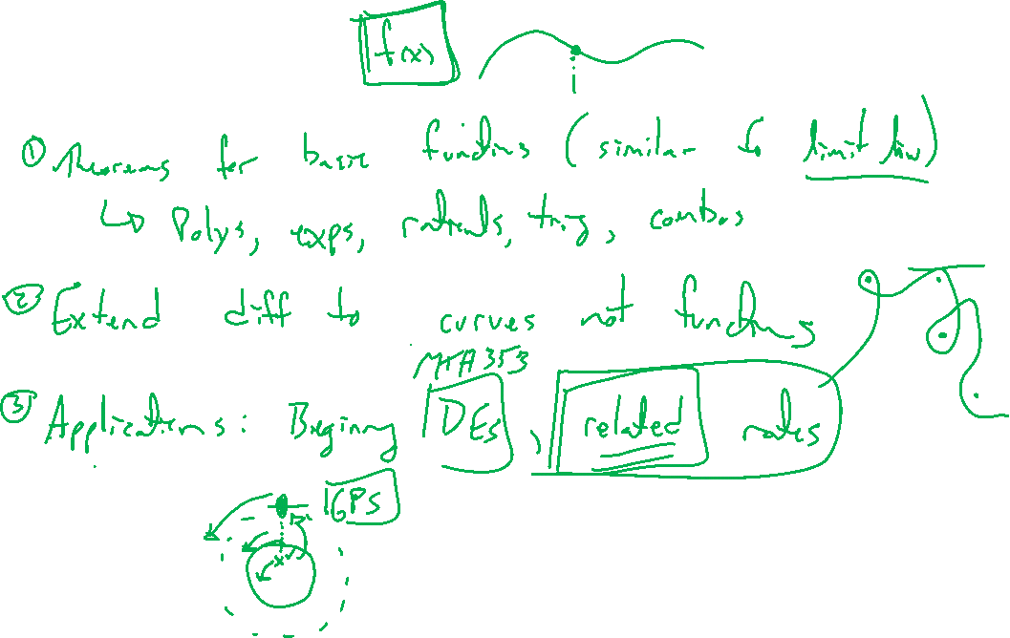
Outline of Chapter
Notes:
Easy way to diff simple functions (think limit laws)
- Polys, exps, rationals, trig, also combos of these.
Extend to curves which are not functions (implicit curves)
Apply to two problems: Beginning DEs, related rates.

